Slide 1
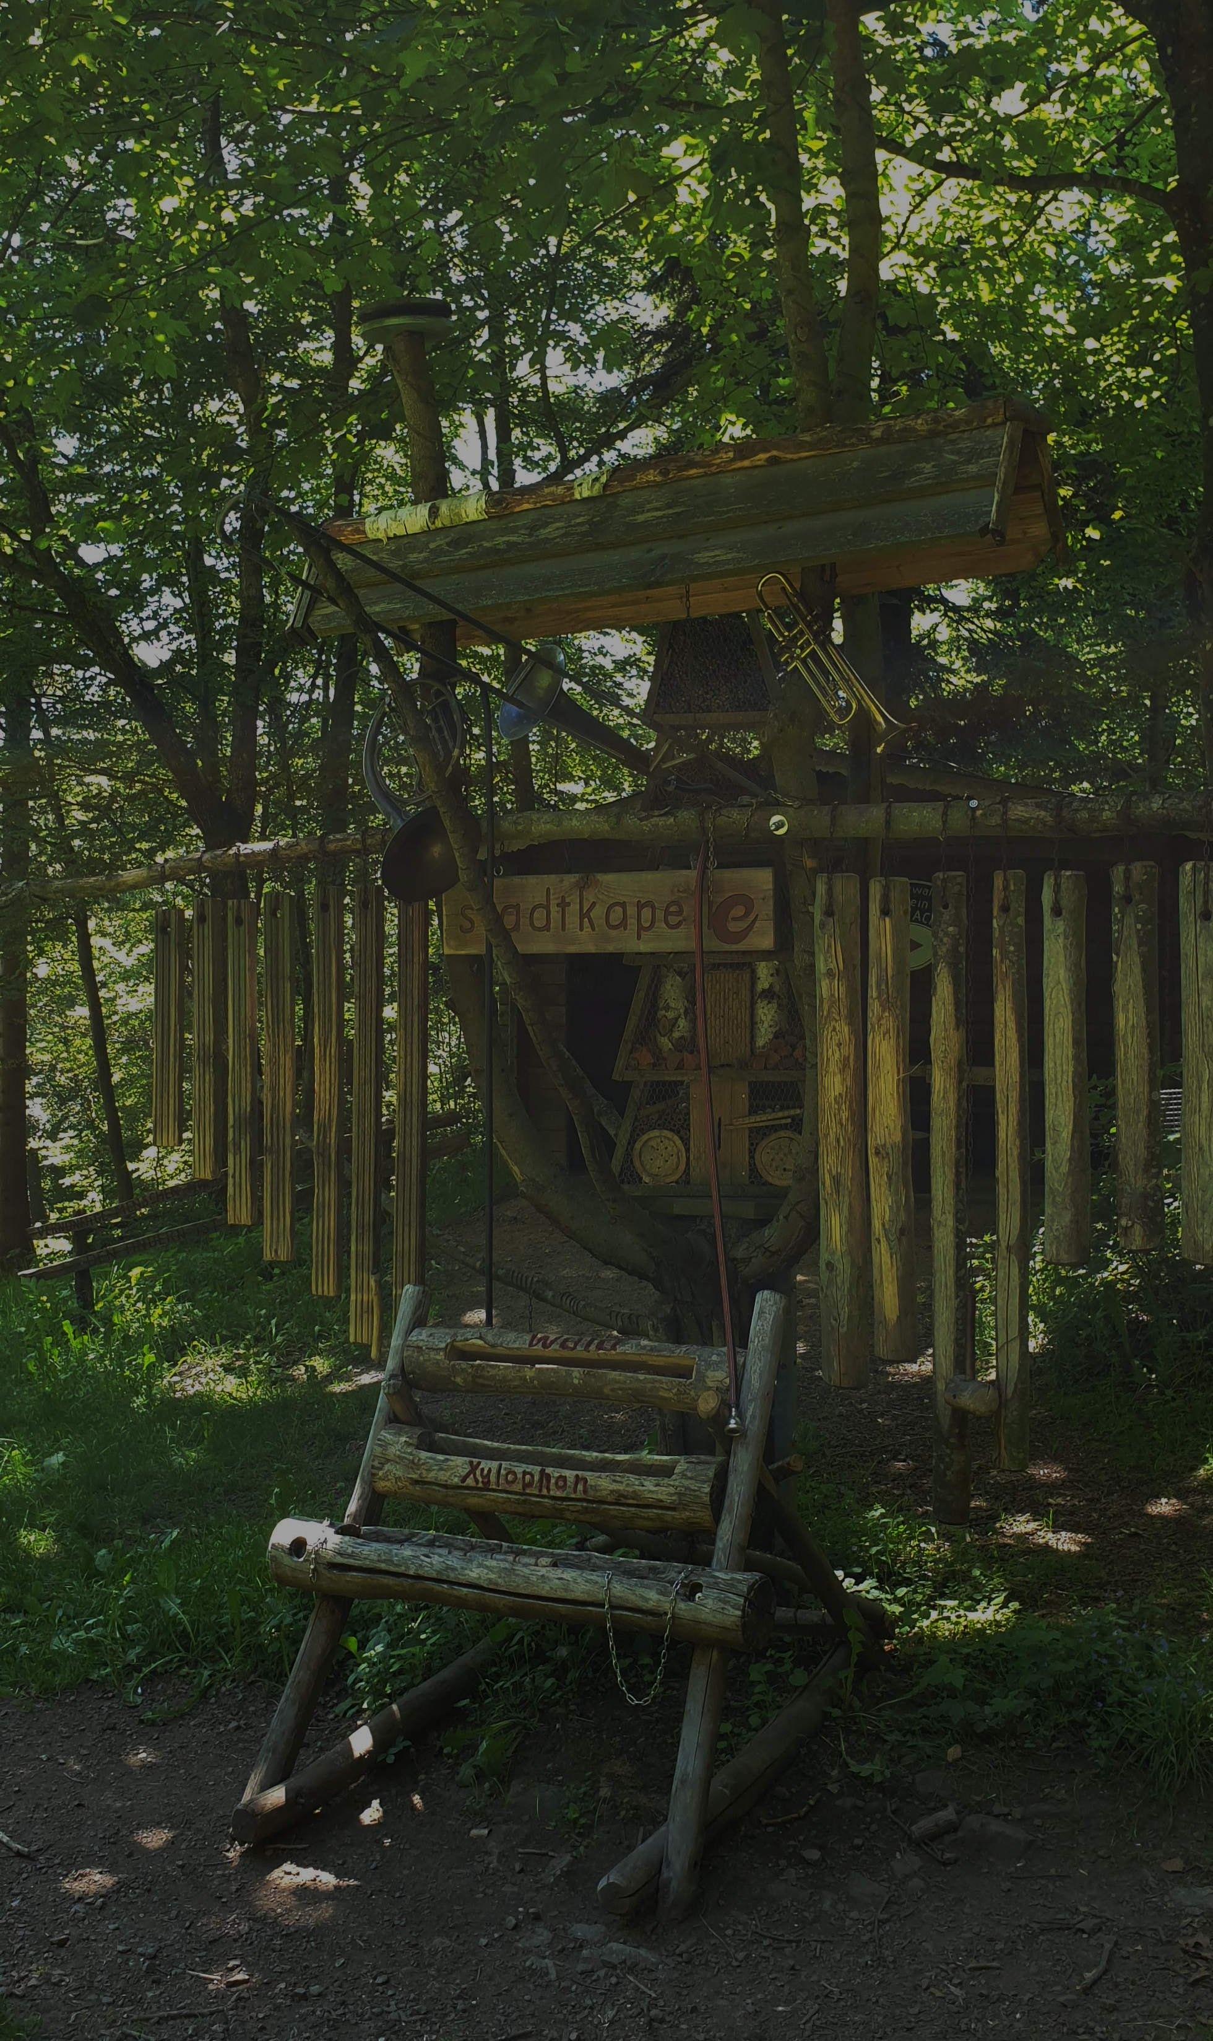

Steven Hoyt

Slide 2

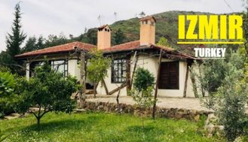
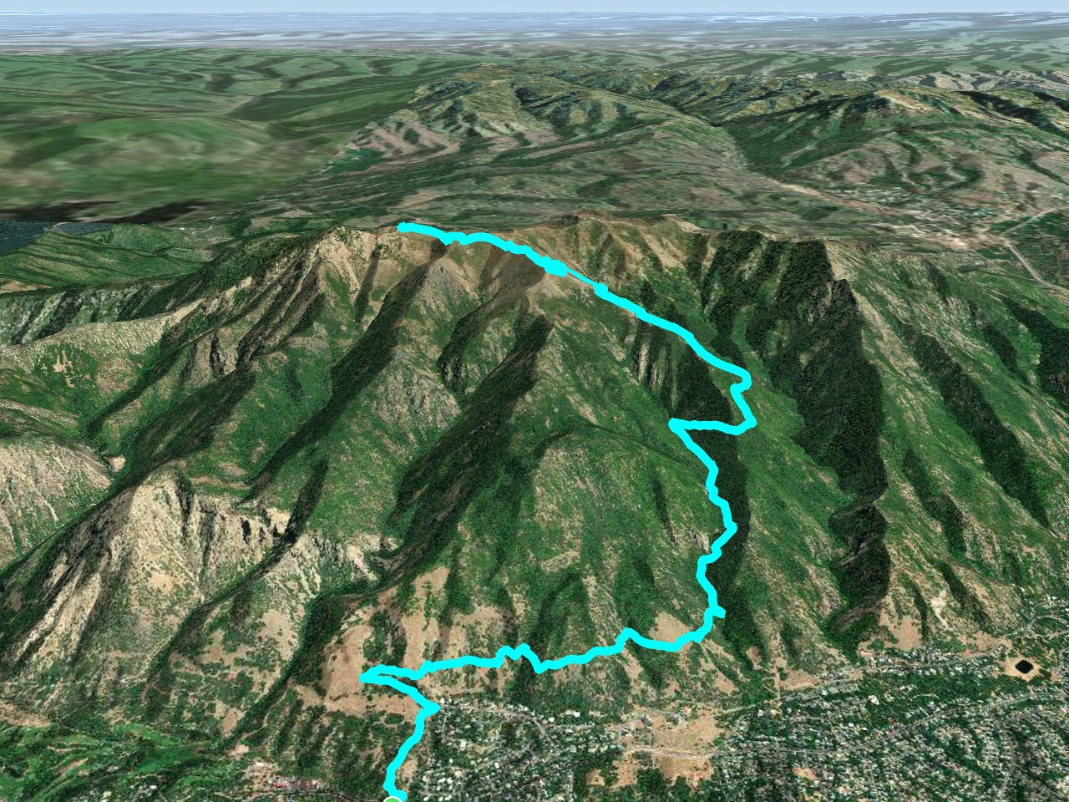
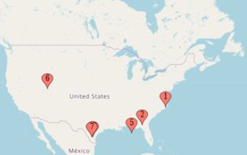
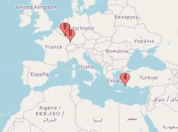
was a journey all over.
Growing Up…
Langley AFB Robins AFB Brunssum AB Izmir AS Eglin AFB
Hill AFB
Lackland AFB
MT. OGDEN
UTAH

Slide 3
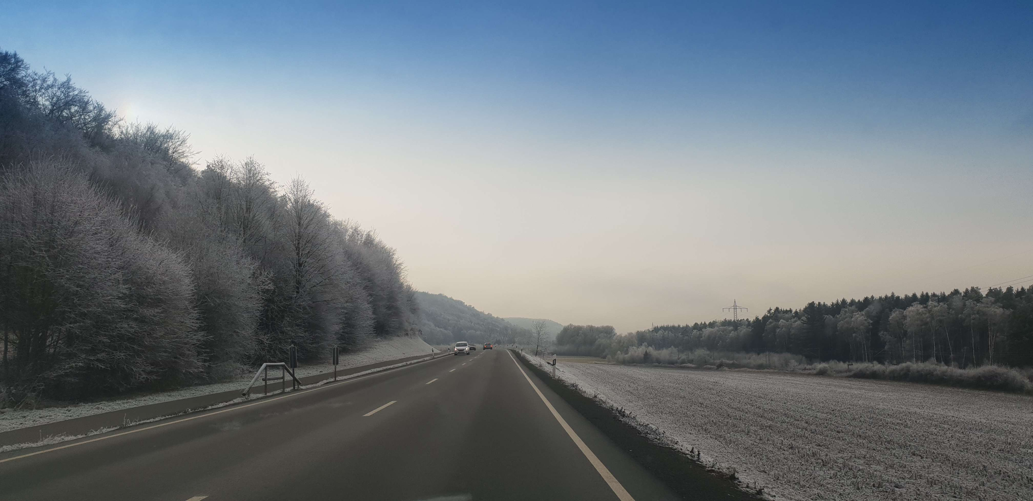
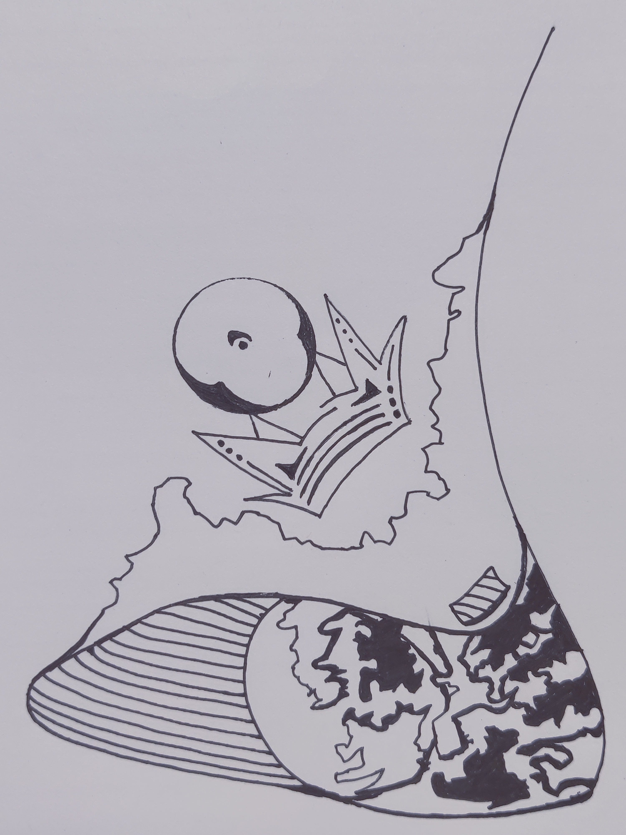
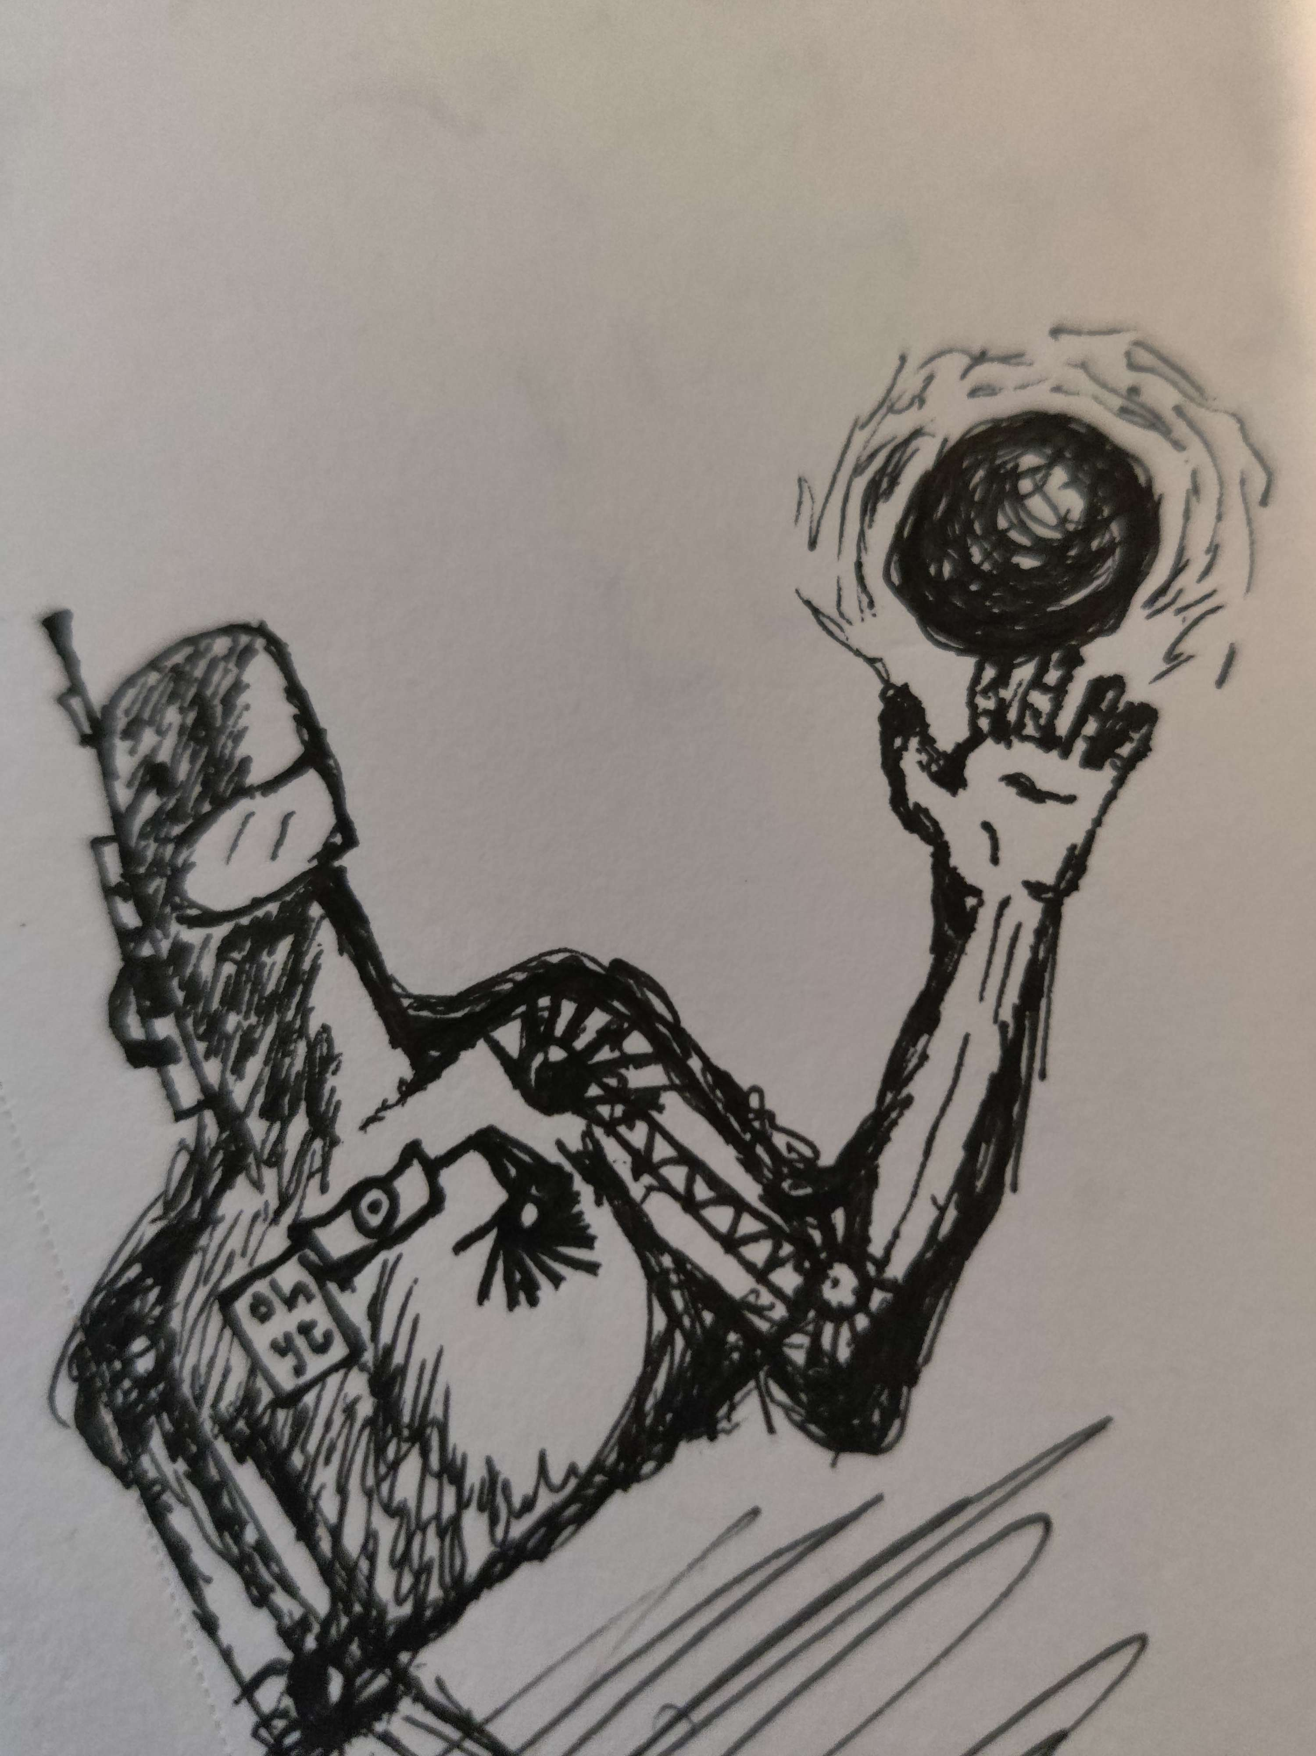
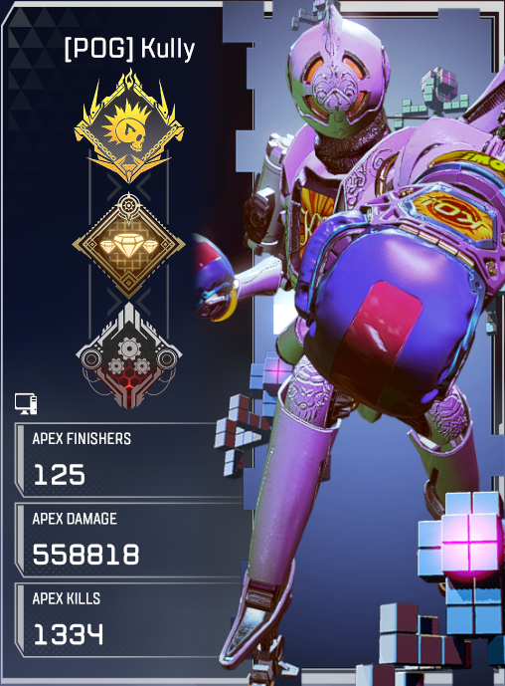
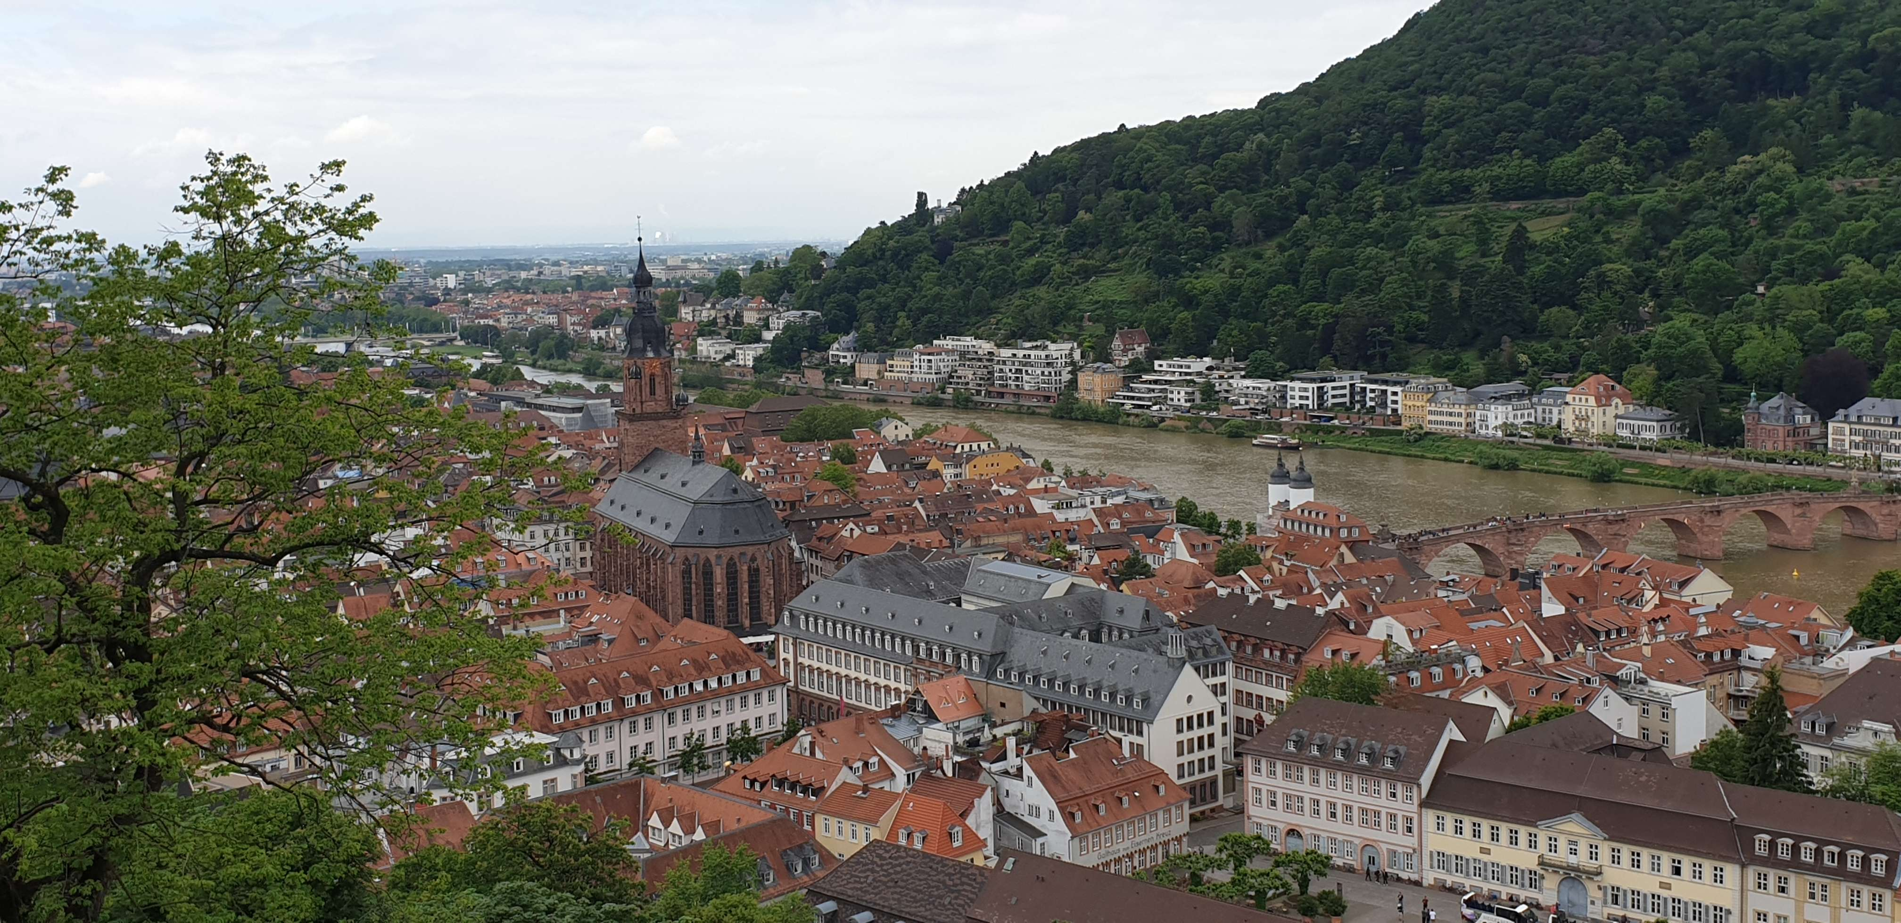
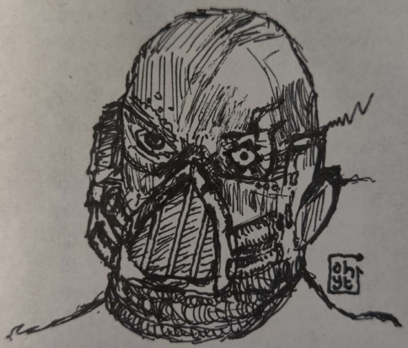
artist gamer traveler
I am a…
contemporary
FPS & PC
small-time

Slide 4

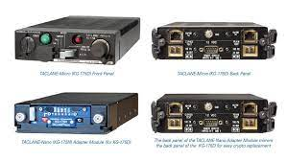
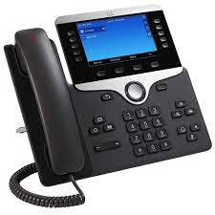
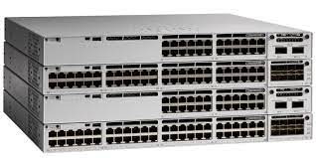
Netman Technician
USAF…
CST
QA & WIT
2 years CST in Germany
- Lots of computers. Too many.
2 years backshop netman in Maryland
- Lots of phones. Way too many.
- Taclanes always work
2 years QA and WIT also in Maryland
- Lots of exercises. Can’t get enough.

Slide 5



Going forward…
certs, certs, more certs
After skillstorm: OR or CA
- Get paid, get certs, get paid more
After OR or CA: Sweden or Denmark
- Med student, lose money
After Med school: Education
- Teach others, lose more money

Slide 6
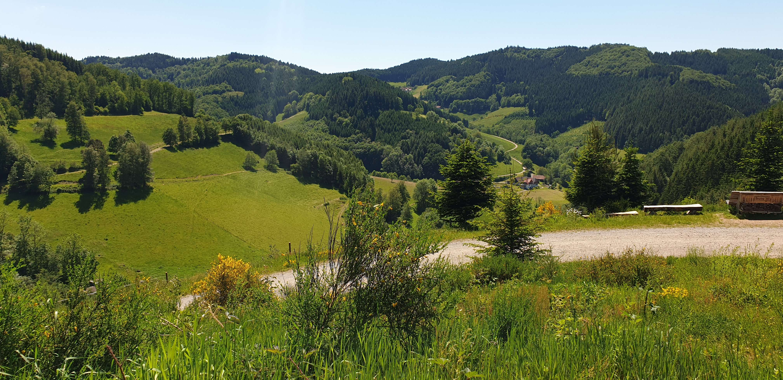
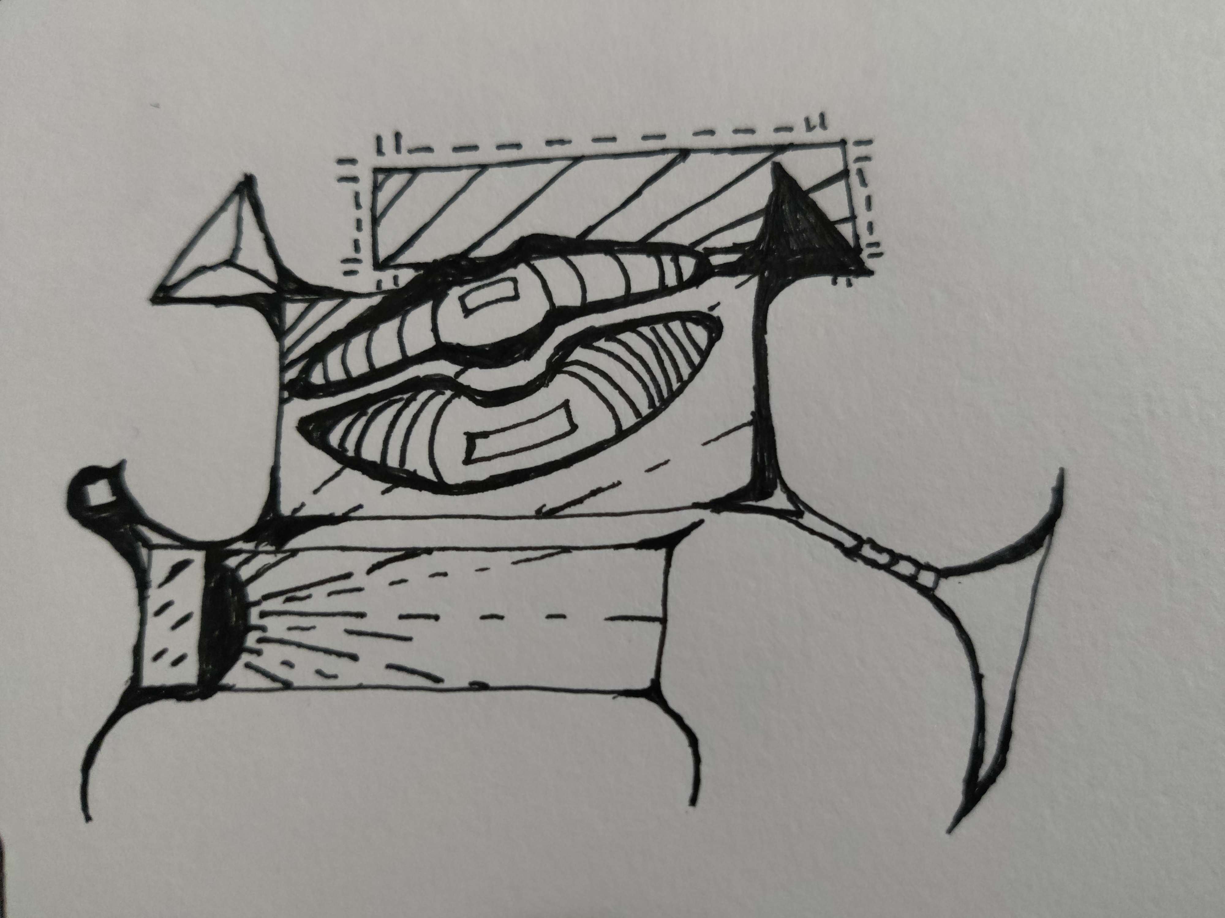
Questions?
Stormer
Spotlight

